Slide 1
Tableau - Worksheets

Slide 2
Tableau – Add Worksheets
Worksheet is the area where you create the views for data analysis.
Tableau provides three blank worksheets where we have established a connection to the data source.
Multiple worksheets can be added to look at different data views in the same screen.

Slide 3
Tableau – Add Worksheets
Adding a Worksheet:
Worksheet can be added in two ways.
Right – click on the name of the worksheet and choose the option new worksheet from the popup menu.
We can also click on the small icon to the right of the last sheet name to add a worksheet.

Slide 4
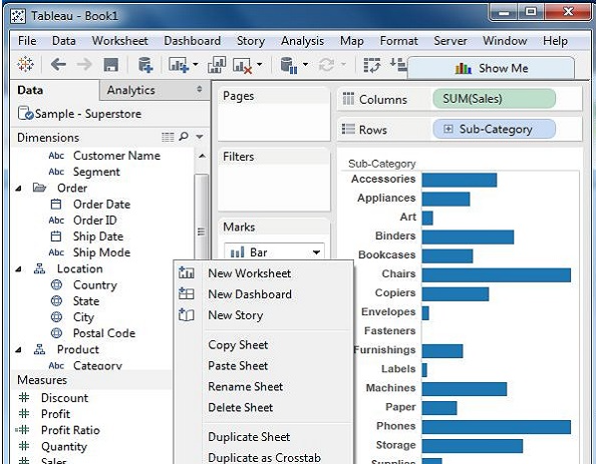
Tableau – Add Worksheets

Slide 5
Tableau – Add Worksheets
Quick Preview Of the Worksheet:
If we stay in one worksheet , we can have a quick preview of another worksheet by hovering the mouse on the name of the other worksheet.

Slide 6
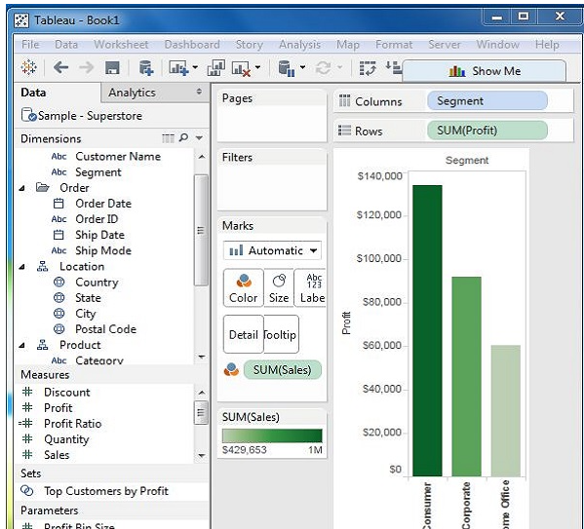

Slide 7
Tableau – Rename Worksheet
We can give appropriate names to the existing worksheets by renaming a worksheet.
This helps in relating the contents of the worksheet with the name.
For eg , if we know the segment wise profit then with the proper sheet of the name , we can identify it.

Slide 8
Tableau – Rename Worksheet
Renaming the Worksheet:
To rename a worksheet , right – click the sheet name and choose the option Rename sheet.

Slide 9
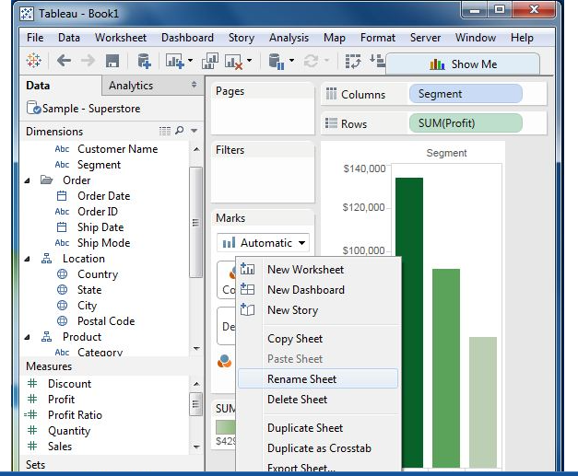
Tableau – Rename Worksheet

Slide 10
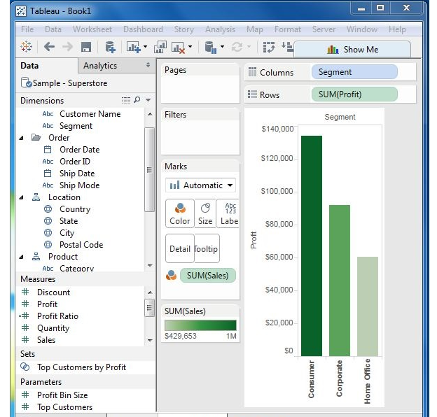
Tableau – Rename Worksheet
The following diagram shows the worksheet with the new name.

Slide 11
Tableau – Save and Delete Worksheet
An existing worksheet can both be saved and deleted.
This helps in organizing the contents in the Tableau desktop environment.
We can save a worksheet by clicking the save button under the main menu .

Slide 12
Tableau – Save and Delete Worksheet
Deleting the Worksheet:
To delete a worksheet , right-click on the name of the worksheet and choose the option “ Delete Sheet”.

Slide 13
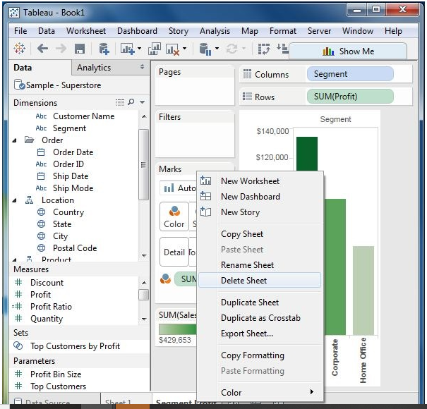
Tableau – Save and Delete Worksheet
Deleting the Worksheet:

Slide 14
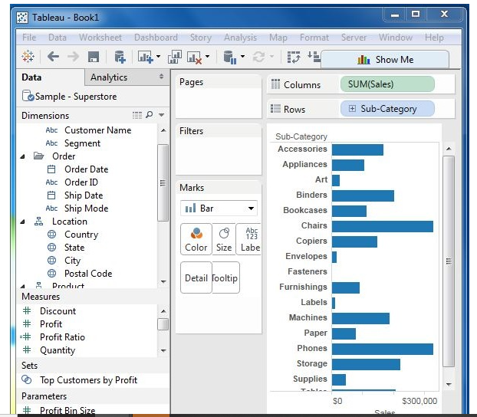
Tableau – Save and Delete Worksheet

Slide 15
Tableau – Reorder Worksheet
To reorder a worksheet , click and hold the worksheet name and move it to the desired position.

Slide 16
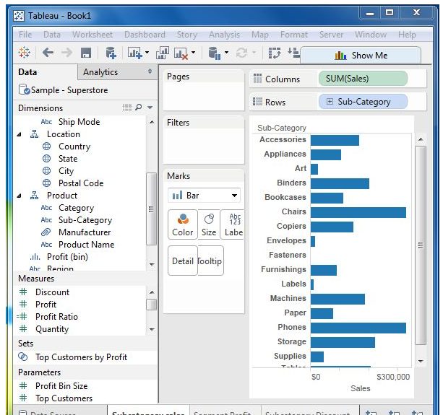
Tableau – Reorder Worksheet

Slide 17
Tableau – Reorder Worksheet
The following screenshot shows that a vertical dark line appears in the new position on dragging the third worksheet from the left to the new position.

Slide 18
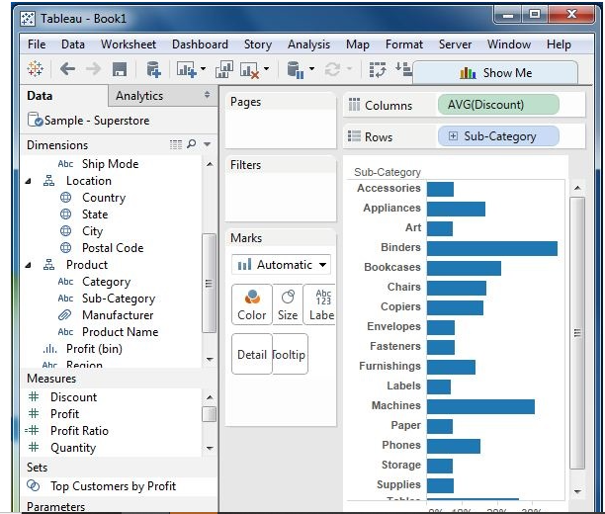
Tableau – Reorder Worksheet

Slide 19
Tableau – Paged Workbook
A paged workbook is used to save the view of the data in different pages for different values of the dimension or measure.
A common example is to see how each type of products have performed against each other in a specific sales region.
As each of the values of product is stored as a separate page ,
We can see one at a time or see it as a range of values.

Slide 20
Tableau – Paged Workbook
Creating Paged Workbook:
The paged workbook contains worksheets which have fields put in the page shelf.
Consider an example of studying the profit of various sub – category of products in different regions.

Slide 21
Tableau – Paged Workbook
Step 1:
Create a bar chart with two dimensions and one measure.
Drag the measure profit to the columns shelf and the dimensions sub-category , and Region to the rows shelf .

Slide 22
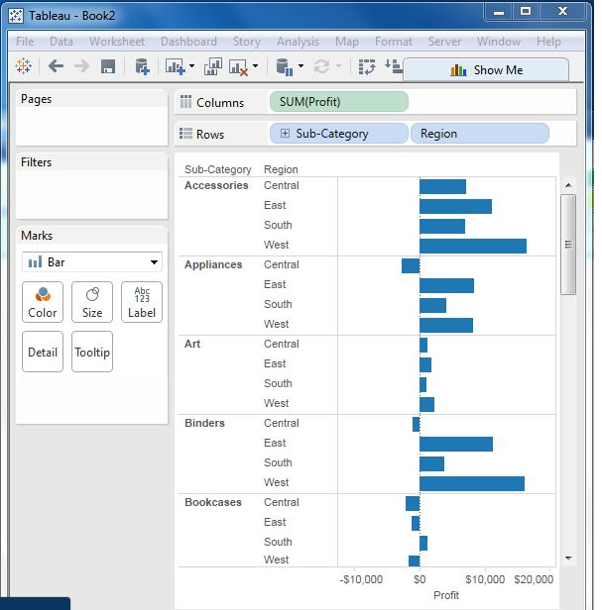
Tableau – Paged Workbook

Slide 23
Tableau – Paged Workbook
Step 2:
Drag the sub-category field again to the page shelf.
We will see that a page control is automatically added below the pages shelf.
Jump to a specific page.
Manually advance through the pages.
Automatically advance through the pages.

Slide 24
Tableau – Paged Workbook
In this case , we will see how to jumpp to a specific page and get the automatic display of pages.
To go to a specific page , click on the drop – down on the page control and select Accessories.

Slide 25
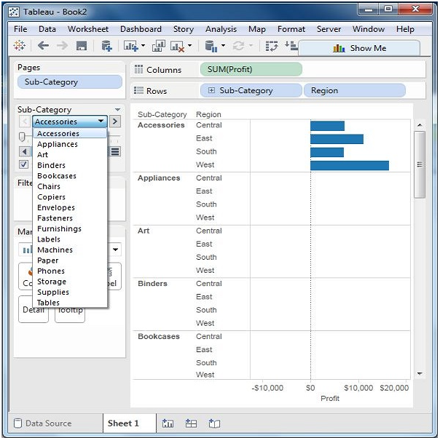
Tableau – Paged Workbook

Slide 26
Tableau – Paged Workbook
Step 3:
For automatic display of pages , keep the show history checkbox ticked and click the play button.
We can then see an automatic play of different pages of sub categories.
The current sub-category value is shown with a dark colour , the previous values are shaded with light colour.

Slide 27
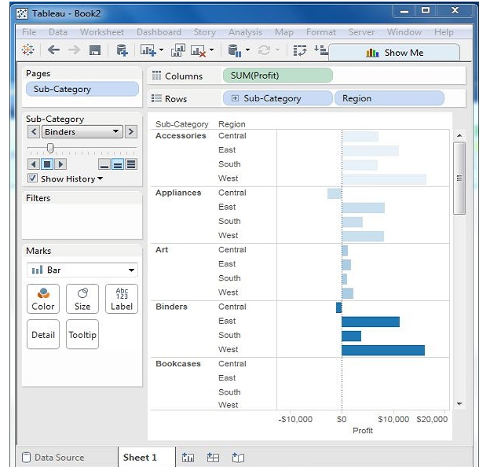
Tableau – Paged Workbook

